Slide 1
DIGGS Data Schema Overview
DIGGS Hack-a-Thon 2026

Slide 2
Overview
XML and DIGGS (DIGGS 101)
DIGGS Data Model Overview

Slide 3
What is DIGGS?
XML Schema documents (XSD), dictionaries defining controlled terms and coordinate systems, and business rules
The schema is the normative document
Defines data structure, objects, and properties for transferring geotechnical, geologic, geoenvironmental and hydrologic data
Enforces rules for data organization
Data is stored/transferred as XML (structured text) instances (files or streaming) that follow DIGGS schema structure

Slide 4
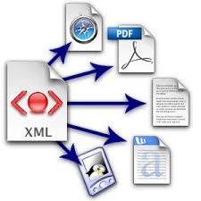
What is XML?
eXtensible Markup Language - a data serialization format used to represent and exchange structured data.
Human readable, text-based, tree-like structure with user-defined tags - platform independent
Can accommodate complex data relationships and structures unlike other text-based formats (eg. CSV, JSON)
Mature, open-source and commercial tools exist for validating, querying, processing, displaying, and transforming XML data.
Notes:
Especially well suited for standards (like DIGGS) that require strict data validation

Slide 5
What is DIGGS?
DIGGS is based on Geography Markup Language (GML), a specialized XML vocabulary for storing and transferring spatial data
Geologic/geotechnical data is inherently spatial
GML is an international standard (ISO/OGC)
GML has standardized Feature and data types for geometries, coordinate reference systems, coverages, etc.
Readily adopted for display andmanipulation of data over the Internet using web map services
Notes:
(GML) is the XML grammar defined by the Open Geospatial Consortium (OGC) to express geographical features. GML serves as a modeling language for geographic systems as well as an open interchange format for geographic transactions on the Internet. Key to GML's utility is its ability to integrate all forms of geographic information, including not only conventional "vector" or discrete objects, but coverages (see also GMLJP2) and sensor data.

Slide 6
What is DIGGS?
DIGGS defines a structure for describing real-world objects and activities common to geotechnical and geoenvironmental practice, and how they inter-relate
DIGGS is extensible
Flexible framework for adding objects not already included in the standard
Able to reference non-text data (photos, docs, etc.) as part of the transfer standard
DIGGS does not dictate practice
Rather, it is a framework that allows test specifications, procedures, etc. to be documented as part of the data transfer/storage protocol.
DIGGS is profilable
Can restrict the schema to enforce business rules for specific use cases

Slide 7
DIGGS 101
Diggs inherits its overall structure from its parent types
XML
GML
Diggs

Slide 8
DIGGS 101
What does a DIGGS instance look like?
A collection of ELEMENTS (tagged text) enclosed within a root element
An element can have zero or multiple attributes
The value of an element can be text, or other elements
Elements with a text value are of simpleType
Elements that contain elements are of complexType
<name attribute=“attribute value”>value</name>
<Diggs>
<samplingFeature>
<Borehole gml:id=“abc”>
<gml:name>Borehole 1</gml:name>
</Borehole>
</samplingFeature>
</Diggs>

Slide 9
DIGGS 101
What is the DIGGS Schema?
XML file that describes how DIGGS “instances” (data files or streams) are structured
Defines elements that are allowed
Defines element types and value restrictions, defaults, fixed values, etc.
Defines how elements are composited
Sequence: (elements are required to occur in a specific order
Choice: (allows one of a group of elements to occur within a sequence
Defines element substitutions
Defines namespaces used (vocabularies allowed)

Slide 10
DIGGS 101
As DIGGS relies on GML, it conforms to GML’s required nomenclature, definitions, conventions
GML defines two types of XML elements
Object
An element of complexType with optional “identity” that is derived (inherits) from a base “abstract” GML type (UpperCamelCase)
Property
An element of simple type or ”propertyType” that is contained within an object (lowerCamelCase)
Simple example: Road is an object; gml:name, numLanes and pavementType are properties of the road object
<Road gml:id=“r1”>
<gml:name>Main St.</gml:name>
<numLanes>4</numLanes>
<pavementType>concrete</pavementType>
</Road>

Slide 11
DIGGS 101
DIGGS base types
DIGGS Objects
Derive from gml objects but may contain geometry properties
Contain the following optional properties
gml:id (attribute; mandatory in some cases)
gml:description
gml:identifier
gml:name
status (release status and/or quality control info for the object)
remark
Some DIGGS object variants require gml:name or may remove all optional elements except for gml:id.
Notes:
The gml:id is used for referencing objects to each other. For example, a borehole that was created as part of a project will reference the id of the project in the borehole’s projectRef property. This is how major associations are made, rather than nesting a borehole within the project object in a hierarchical form.

Slide 12
DIGGS 101
DIGGS features
"high level" DIGGS objects - that tend to be referenced outside of the XML hierarchy
Mandatory gml:id
Often contain geometry objects
Plus optional:
gml:internaldentifier
associatedFile
role
Some DIGGS feature variants require gml:name or may remove some optional elements

Slide 13
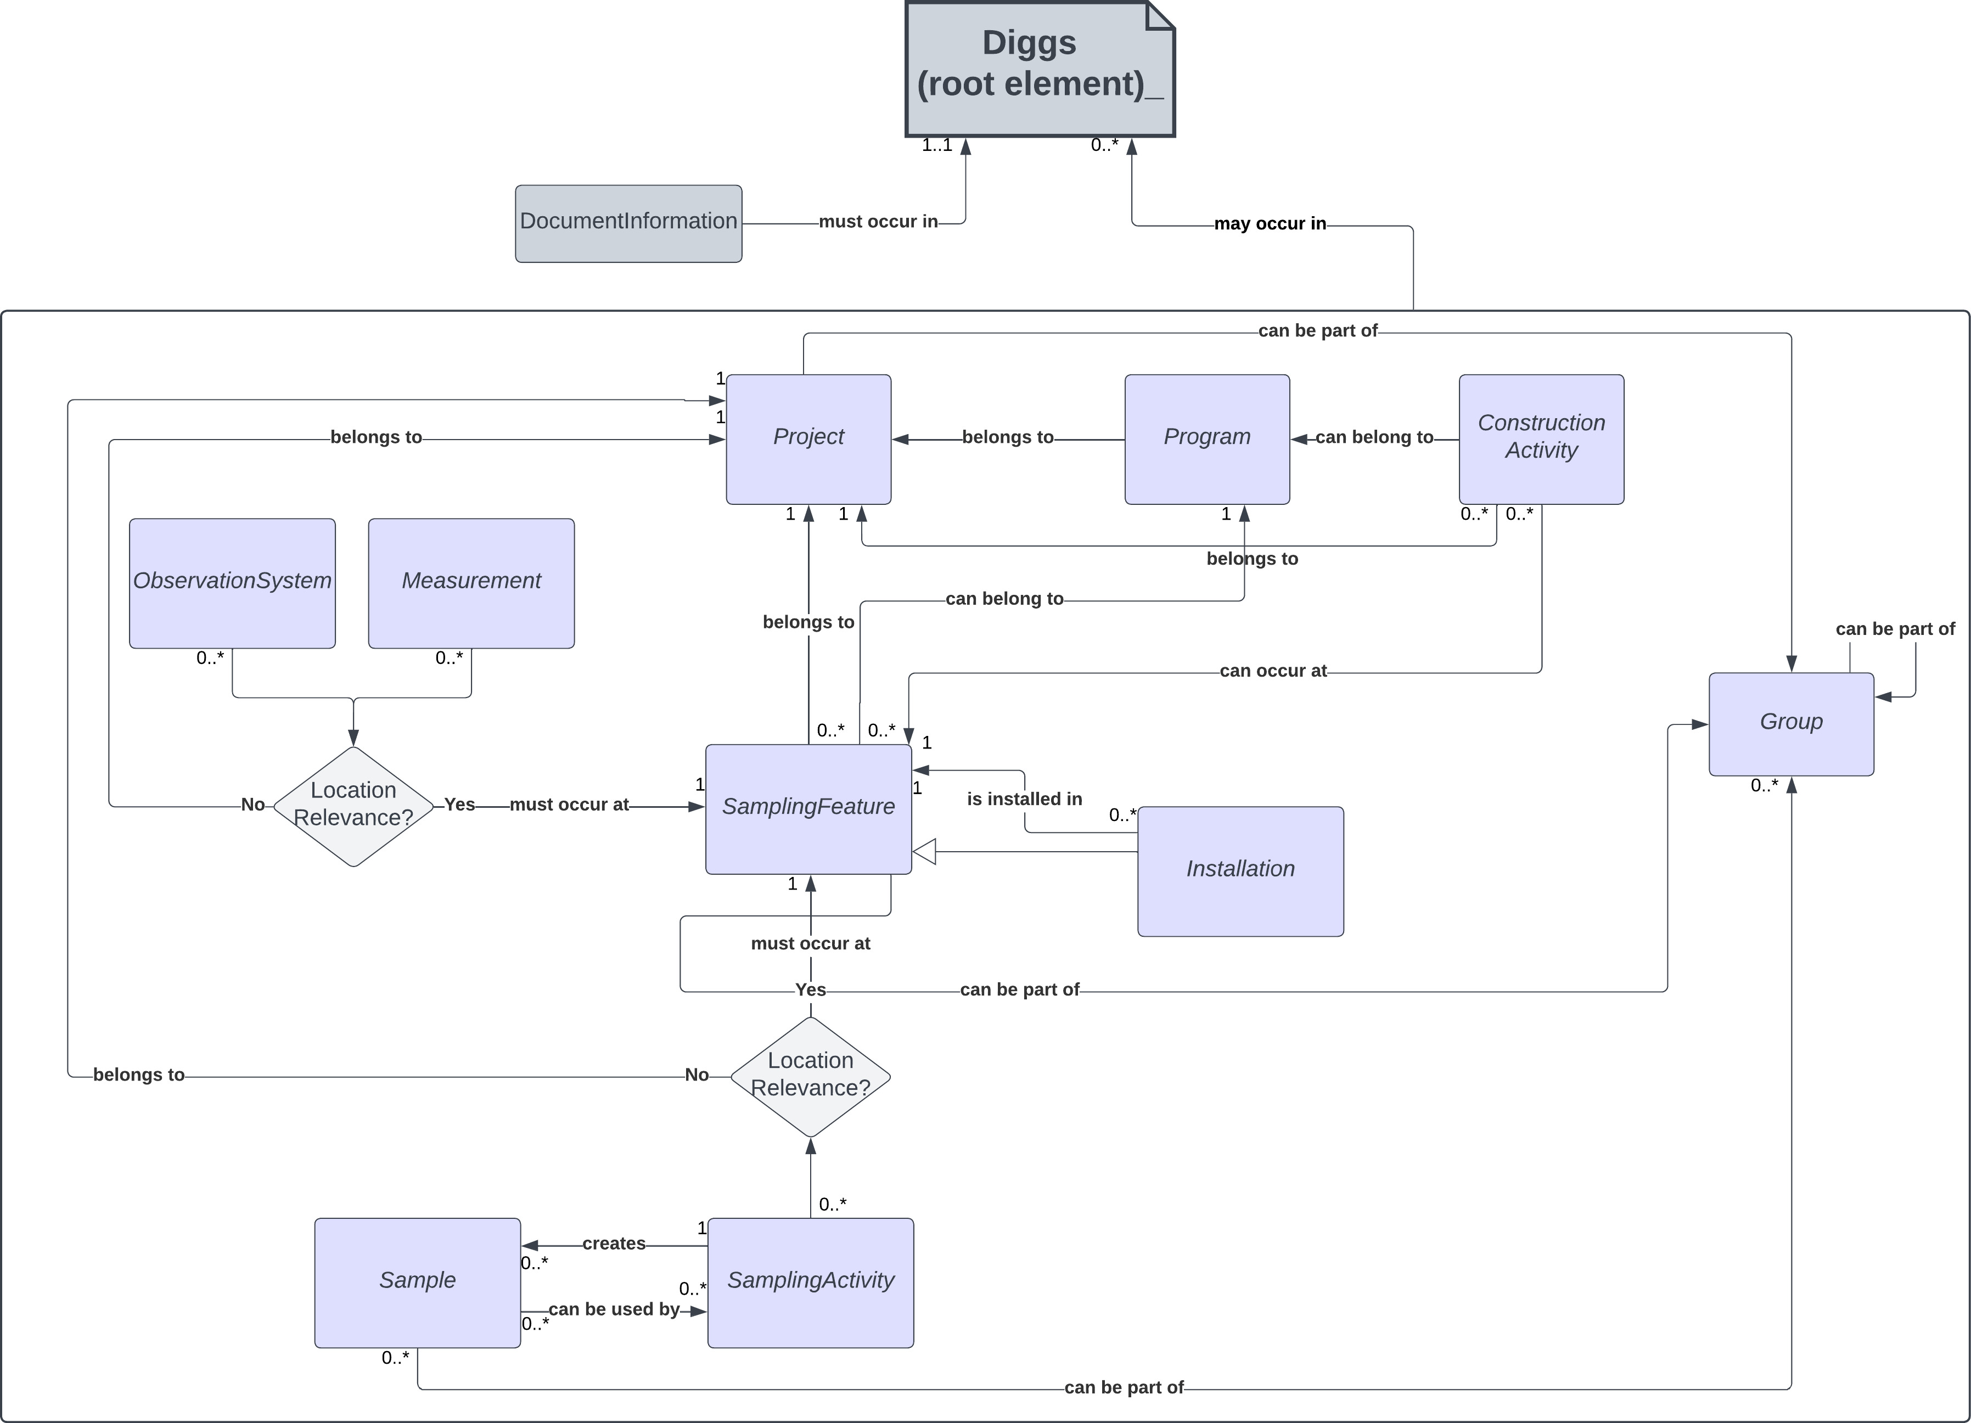
DIGGS Data Model
Notes:
A DIGGS instance consists of a number of modular component objects that are nested within the properties above under a single Diggs object. A DIGGS instance is only required to have the documentInformation property, which provides information about that particular data transmission and optionally a history of past transmission versions. All other properties are optional. This allows for sharing of component pieces of a domain of information. For example, a DIGGS file may contain only sample information for transmission to a laboratory for analysis, whereas the returning DIGGS transmission from a laboratory may contain only the relevant measurement results.

Slide 14
DIGGS Data Model
Project
A collection of sampling features, activities, samples, observation systems and measurements that form a business activity.
All classes of DIGGS objects must belong to a project
Currently only one (generic) concrete Project object exists
Contains optional location properties and those associated with a business activity – eg. purpose, events, contracts
Notes:
A DIGGS instance consists of a number of modular component objects that are nested within the properties above under a single Diggs object. A DIGGS instance is only required to have the documentInformation property, which provides information about that particular data transmission and optionally a history of past transmission versions. All other properties are optional. This allows for sharing of component pieces of a domain of information. For example, a DIGGS file may contain only sample information for transmission to a laboratory for analysis, whereas the returning DIGGS transmission from a laboratory may contain only the relevant measurement results.

Slide 15
DIGGS Data Model
Sampling Feature
A physical object or location through which we observe or measure properties of the earth, or perform some type of activity. It serves to define the dimensionality, extent, and local spatial reference system for zones where observations or activities take place.
Notes:
A DIGGS instance consists of a number of modular component objects that are nested within the properties above under a single Diggs object. A DIGGS instance is only required to have the documentInformation property, which provides information about that particular data transmission and optionally a history of past transmission versions. All other properties are optional. This allows for sharing of component pieces of a domain of information. For example, a DIGGS file may contain only sample information for transmission to a laboratory for analysis, whereas the returning DIGGS transmission from a laboratory may contain only the relevant measurement results.

Slide 16
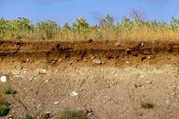
We observe/measure properties of the earth via a sampling feature
TrenchWall
Borehole

Slide 17
Diggs Sampling Features (v. 3.0)
0D (modeled by a GML Point)
Station
1D (modeled by a GML LineString)
Borehole
Sounding
Transect
TrialPit (AGS Legacy)
GP_Trackline
GroutTrenchCutoffWall
Installations
Well
ConcretePile
SteelHPile
SteelPipePile
TimberPile
2D (modeled by a GML Polygon)
GP_ArealSurvey
PlanarSamplingFeature
TrenchWall
3D (modeled by a GML Solid)
VolumetricSamplingFeature

Slide 18
Sampling Features define the geographic and geometric context of the data we obtain
(x₁,y₁,z₁)
1D SamplingFeatures (eg. Borehole)
referencePoint (GML point)
Usually at one end of the borehole path
Eg. top of hole at land surface, rig table, etc.)
Represented in 3 dimensions (x, y, z)
Useful for map view representations
<referencePoint> <PointLocation gml:id="pl-B-01" srsDimension="3"
srsName="https://www.opengis.net/def/crs-compound?1=http://www.opengis.net/def/crs/EPSG/0/4326%26
2=http://www.opengis.net/def/crs/EPSG/0/6360" uomLabels="dega dega ft"> <gml:pos>30.429139 -91.212861 19.00</gml:pos> </PointLocation> </referencePoint>

Slide 19
Sampling Features define the geographic and geometric context of the data we obtain
(x₁,y₁,z₁)
Borehole Geometry
centerLine (GML LineString)
A connected set of vertices that define the borehole path
Represented in 3 dimensions
A borehole can have more than one centerLine property
(x₁,y₁,z₂)
<centerLine> <LinearExtent gml:id="cl-B-01" srsDimension="3"
srsName="https://www.opengis.net/def/crs-compound?1=http://www.opengis.net/def/crs/EPSG/0/4326%26
2=http://www.opengis.net/def/crs/EPSG/0/6360" uomLabels="dega dega ft"> <gml:posList>30.429139 -91.212861 19.00 30.429139 -91.212861 -141</gml:posList> </LinearExtent> </centerLine>

Slide 20
Can DIGGS represent inclined or deviated boreholes?
YES!! (it’s all in the gml:posList property)
(x₁,y₁,z₁)
(x₁,y₁,z₁)
(x₁,y₁,z₁)
(x₂,y₂,z₂)
(x₃,y₃,z₃)
(x₄,y₄,z₄)
<gml:posList>x1 y1 z1 x2 y2 z2 x3 y3 z3 x4 y4 z4</gml:posList>
(x₂,y₂,z₂)
<gml:posList>x1 y1 z1 x2 y2 z2</gml:posList>
(x₁,y₁,z₂)
<gml:posList>x1 y1 z1 x1 y1 z2</gml:posList>

Slide 21
How do we represent the position of samples/measurements within a borehole?
(x₁,y₁,z₁)
Linear referencing
Measured
Depth = 5 ft
<linearReferencing> <LinearSpatialReferenceSystem gml:id="cptsr1"> <gml:identifier codeSpace=”LADOT"> LADOT:cptsr1</gml:identifier> <glr:linearElement xlink:href="#ls1"/> <lrm>
<LinearReferencingMethod gml:id="md_ft">
<gml:description>
Absolute measured depth from top of borehole or sounding in feet.
Measurements are cumulative 3D distance along the borehole/sounding centerline
from the first coordinate (typically top of hole or rig datum) proceeding downward through
the hole. Suitable for vertical, slanted, and deviated boreholes and soundings.
</gml:description>
<.gml:identifier codeSpace="https://diggsml.org/def/authorities.xml#DIGGS">
https://diggsml.org/def/crs/DIGGS/0.1/lrm.xml#md_ft</gml:identifier>
<name>trueFootage</name>
<type>absolute</type>
<units>ft</units>
<positiveDirection>downward</positiveDirection>
</LinearReferencingMethod>
</lrm>
</LinearSpatialReferenceSystem>
</linearReferencing>
Measured
Depth = 8-9 ft
(x₁,y₁,z₂)
<sampleLocation> <PointLocation gml:id="pt1-2" srsName="#cptsr1" srsDimension="1"> <gml:pos>5</gml:pos> </PointLocation> </sampleLocation>
<sampleLocation> <LinearExtent gml:id=”cr1-2" srsName="#cptsr1" srsDimension="1"> <gml:posList>8 9</gml:posList> </LinearExtent> </sampleLocation>

Slide 22
DIGGS Data Model
Sample
A specimen of. earth material, fluid, or gas that is obtained as a result of a sampling activity, for the purpose of observation and/or testing
Sampling Activity
The action taken to obtain or produce a material sample, although the activity may not produce a sample (eg. a core run that produces no recovery). This activity typically occurs at a location on a sampling feature, or could occur elsewhere (eg. a laboratory) in the case of test or blank samples, or can produce aggregate samples where the location of the samples produced have no meaning. All
material samples must refer to a SamplingActivity.
……
Notes:
A DIGGS instance consists of a number of modular component objects that are nested within the properties above under a single Diggs object. A DIGGS instance is only required to have the documentInformation property, which provides information about that particular data transmission and optionally a history of past transmission versions. All other properties are optional. This allows for sharing of component pieces of a domain of information. For example, a DIGGS file may contain only sample information for transmission to a laboratory for analysis, whereas the returning DIGGS transmission from a laboratory may contain only the relevant measurement results.

Slide 23
SamplingActivity
Samples are collected from sampling features as a result of sampling activities. Sampling activities can also produce samples by aggregation, subsampling or by creating a test standard in a lab, a grout sample, etc.
SamplingActivity SA-1 from 5-8 ft
5
Sample S-1
Sample extent from 5-7 ft
SampleProduced SP-1
from 5-6 ft
8
Sample S-2
SampleProduced SP-2
from 6-6.5 ft
Sample S-4
Sample S-5
Sample S-3
SampleProduced SP-3
from 6.5-7 ft
Sample S-6
SamplingActivity SA-2 (subsampling)
Borehole

Slide 24
DIGGS Data Model
Observations
……
Notes:
A DIGGS instance consists of a number of modular component objects that are nested within the properties above under a single Diggs object. A DIGGS instance is only required to have the documentInformation property, which provides information about that particular data transmission and optionally a history of past transmission versions. All other properties are optional. This allows for sharing of component pieces of a domain of information. For example, a DIGGS file may contain only sample information for transmission to a laboratory for analysis, whereas the returning DIGGS transmission from a laboratory may contain only the relevant measurement results.

Slide 25
DIGGS Data Model
Observation (ISO 19156)
An observation is an act associated with a discrete time instant or period through which a number, term or other symbol is assigned to a characteristic. This act involves application of a specified procedure, such as a sensor, instrument, algorithm or process chain. The procedure may be applied in-situ, remotely, or ex-situ with respect to the sampling location. The result of an observation is an estimate of the value of a property of some feature; an observation is a property-value-provider for a feature-of-interest. Use of a common model allows observation data using different procedures to be combined unambiguously

Slide 26
DIGGS Data Model
DIGGS considers two types of Observations:
Observation Systems
Measurements
DIGGS Observation Systems
Collection of spatially associated observations with the same set of property-value results
Results derives from direct human interaction, judgment or analysis.
Typically subjective; often qualitative, category based
Types of DIGGS observations:
Descriptive (eg. color, soil classification, field observations)
Interpretive/Generalization/Modeled
Genesis (eg. alluvium, beach sand)
Formation assignment (time or spatial ordering)
Modeled data (eg. velocity layering)

Slide 27
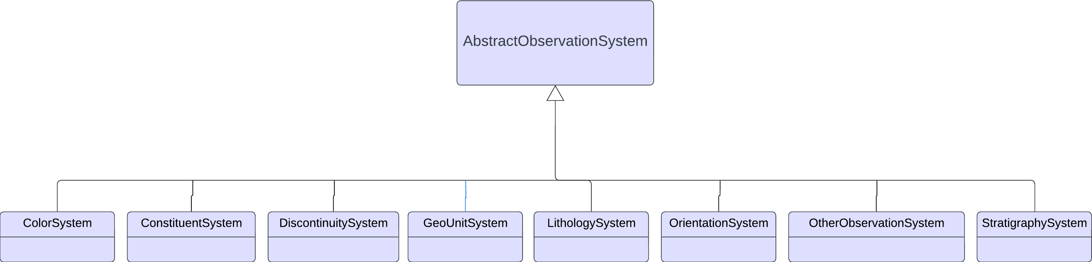
DIGGS Data Model
Observation systems are include a collection of “observation” objects where each object contains properties that are observed at a specific location.
The observation procedure is specified within the observation system

Slide 28
ObservationSystems contain one or more Observation objects, each assigned to a region of a sampling feature
LithologySystem
StratigraphySystem
ColorSystem
CL
10YR 4/2
Other ObservationSystems
ConstituentSystem
DiscontinuitySystem
GeoUnitSystem
OrientationSystem
OtherDescriptionSystem
Fill
10YR 3/1
SM
7.5YR 4/3
Alluvium
5Y 6/3
GP
10YR 6/2
TrenchWall
GC
Briggs
Fm.
Borehole

Slide 29
DIGGS Data Model
Measurement
Results (property-value pairs) derive principally from the use of testing equipment and/or sensors.
Typically objective with high precision results as long as procedures are followed and equipment is operating appropriately; results are usually numeric values, although category assignments can be calculated numeric results.
Types of DIGGS measurements:
Laboratory tests on samples (eg. Particle size, Atterberg limits)
In-situ tests (CPT, SPT, DMT, geophysical tests)
Monitoring Activities (eg. piezometer, pumping tests)

Slide 30
Measurements
Four measurement features in DIGGS
Test – measurements over a spatial domain (lab and in-situ tests)
Monitor – measurements over a temporal domain (monitoring activities)
MaterialTest – measurement on a physical sample that has no location relevance (eg. lab created or aggregated sample)
MeasurementWhileDrilling – time or depth indexed observations of drilling parameters while a borehole is being constructed
All measurements are structured very similarly
Results are reported in a self-describing fashion for extensibility and to support the wide range of measurement results and procedures used in geotechnical and geoenvironmental studies.
Measurements do NOT carry RAW or solely procedural data (eg. tare weights, machine voltages, container ID’s)

Slide 31
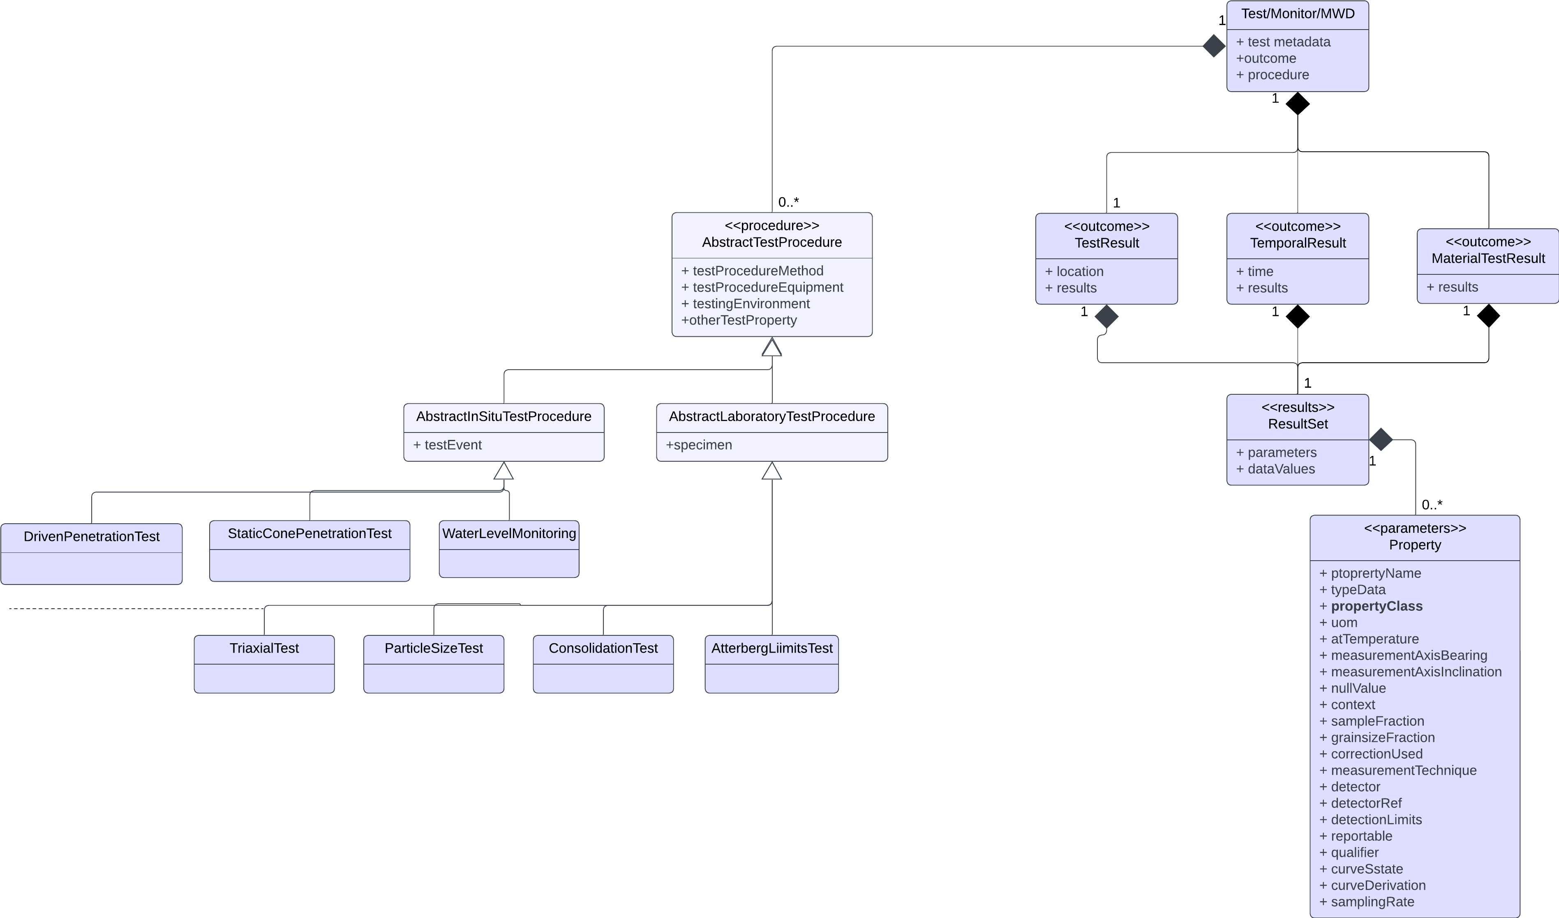
Structure of a Measurement
Result encoding derives from GML coverage
Procedures are specialized according to the specific of the test procedure. They are explicitly defined and may themselves contain observations made to derive the ultimate property-value results of the measurement

Slide 32
<outcome> <TestResult gml:id="altr1"> <location>
<PointLocation gml:id="pl2" srsDimension="1" srsName="#sr123">
<gml:pos>32</gml:pos>
</PointLocation>
</location>
<results> <ResultSet> <parameters> <PropertyParameters gml:id="pp"> <properties> <Property index="1"> <propertyName>LL</propertyName> <typeData>integer</typeData> <propertyClass codeSpace=“https://diggsml.org/def/codes/DIGGS/0.1/properties.xml#liquid_limit”>Liquid Limit</propertyClass> </Property> <Property index="2"> <propertyName>PL</propertyName> <typeData>integer</typeData> <propertyClass codeSpace="https://diggsml.org/def/codes/DIGGS/0.1/properties.xml#plastic_limit"> ">Plastic Limit</propertyClass> </Property> <Property index="3">
<propertyName>PI</propertyName>
<typeData>integer</typeData>
<propertyClass codeSpace="https://diggsml.org/def/codes/DIGGS/0.1/properties.xml#plasticity_index">Plasticity Index</propertyClass>
</Property>
<Property index="4">
<propertyName>Symbol from plasticity chart</propertyName>
<typeData>string</typeData>
<propertyClass codeSpace="https://diggsml.org/def/codes/DIGGS/0.1/properties.xml#uscs_symbol_425”>USCS Symbol</propertyClass>
</Property>
<Property index=”5"> <propertyName>LI</propertyName> <typeData>double</typeData> <propertyClass codeSpace="https://diggsml.org/def/codes/DIGGS/0.1/properties.xml#liquidity_index">Liquidity Index</propertyClass> </Property> </properties> </PropertyParameters> </parameters> <dataValues>
25,12,13,"CL",0.66
</dataValues </ResultSet> </results> </TestResult> </outcome>

Slide 33
DIGGS Data Model
Construction Activity
An activity intended to improve or alter ground conditions.
Notes:
A DIGGS instance consists of a number of modular component objects that are nested within the properties above under a single Diggs object. A DIGGS instance is only required to have the documentInformation property, which provides information about that particular data transmission and optionally a history of past transmission versions. All other properties are optional. This allows for sharing of component pieces of a domain of information. For example, a DIGGS file may contain only sample information for transmission to a laboratory for analysis, whereas the returning DIGGS transmission from a laboratory may contain only the relevant measurement results.

Slide 34
DIGGS Data Model
Program
A program contains properties about the design and specifications for a collection of planned activities and observations associated with a project. These include properties that define the planning and specifications for both exploration efforts and construction activities.
Notes:
A DIGGS instance consists of a number of modular component objects that are nested within the properties above under a single Diggs object. A DIGGS instance is only required to have the documentInformation property, which provides information about that particular data transmission and optionally a history of past transmission versions. All other properties are optional. This allows for sharing of component pieces of a domain of information. For example, a DIGGS file may contain only sample information for transmission to a laboratory for analysis, whereas the returning DIGGS transmission from a laboratory may contain only the relevant measurement results.

Slide 35

Questions?
Repository
github.com/DIGGSml
Schema Documentation
http://diggsml.org/docs/3.0.0

